Slide 1
GROUP-5
Software Engineering Lab Assignment 3 Report
B05-511017020 B05-510417090 510517063
510517010
Anjishnu Mukherjee Sunirban Sarkar Sankhasubhra Mandal Samrat Sarkar

Slide 2
System overview and assumptions
For an online room reservation system (like AirBnB for example), there are primarily 2 kinds of end users interacting with a system. For AirBnB in particular, since the company owns the system, they play the role of administrator of the system, with complete access to the system as well as information about both types of users, restricted by the legal constraints of information privacy for all concerned entities. In this particular document, we assume a similar system, instead of a generic travel booking system, like MakeMyTrip, or a system particular to a hotel chain, like Mariott.
User Classes and Characteristics
Coming to the two types of users, one is the host and the second is the guest. The guest-host interaction is broadly defined as below :
Host :
A host owns a property (or multiple properties) and wants to rent it out to customers. This property is usually referred to as “listing” in many sections of this document. If more than one person jointly owns a property and wants to list it, then all of them must be in agreement, and can login to the same host account to converse with the guest as the host of the property. Multiple people cannot host the same property as different listings to avoid data redundancy issues.
Guest :
A guest (or multiple guests) wants to rent a property (or multiple properties) for a particular time span. A guest can book multiple different listings during the same time span, to account for travelling to different places from a primary location within that period. A guest can’t book a room for a single person, and then check-in with multiple people.
In real life, a person can be both a guest and a host. For this system, if a person is both a guest and a host, 2 separate entities, 1 for each role, will be created in the system, both mapped to their unique user ID. The application will switch between a guest interface and a host interface using a button to facilitate the needs of such users.
Product Functions
Both types of users would also have distinct interactions with the system itself (listed in the expected most common order of occurrence).

Slide 3
Sign up / Login :
Sign up should be facilitated via different integrations like Apple ID, Facebook login, Google login, Email ID, etc.
ID Verification :
The identity of both the host and the guest would need to be verified after sign up. This can be done via verification of identification documents like matching passport photo with a selfie, etc. ID verification needs to be done only once during sign up and not for every login.
- Listings :
Hosts need to list a property on the platform. To do so, they would have to upload a recent picture of every relevant part of the rental part of the property, including a picture of each of the basic amenities they are offering. For verification and security purposes, they need to upload a video of at least 1 minute of length, where they offer a room tour in-person. Along, with this, an accurate location needs to be uploaded to the platform. Guests will only be shown an approximate location of the listing in a circular radius before booking. Once booking is confirmed, the exact address will be shown to the guests.
Primary Guest Input :
Primary compulsory guest input would be the destination. Based on that, the system would display all available property listings. From this list, users can apply secondary inputs to select a property by filtering down the results initially displayed.
Secondary Guest Inputs :
Secondary guest inputs can be none, one or more of the following (not in any particular order) :
number of guests
price range
date range
presence or absence of pets
size of room required
room type (home, private room, apartment, shared room)
basic amenities available (cooking utensils, washing machines, etc.)
number of beds required
number of bathrooms required
desired cancellation policy (strict, flexible)
minimum desired rating of host

Slide 4
Pre-booking stage :
Once the guest has filtered down choices from the above step, they can either save their choices to a list of options that they are considering, or they can proceed for booking their final choice immediately. A maximum of 5 options can be wishlisted at a time.
Booking process, Message system, Cancellation policies :
If a guest wants to book an offering from the host, they would need to contact the host first, via the in-app messaging system to confirm the availability of the room and basic amenities during their stay period. Once both have exchanged at least 1 message, the guest can go ahead and request a booking. The host can then either accept or decline the booking. If the host accepts the booking, the guest would be required to make an upfront payment of 50% of the total amount within the next 24 hours or cancel the reservation. The remaining amount would be charged 24 hours after the guest reaches the room on the specified date, or even if they don’t reach and haven’t cancelled their reservation either. Once booking has been completed along with payment, the event can only be cancelled as per cancellation policies. No updates are allowed. Cancellation policies specified by the host prior to booking in their listings are applicable throughout this entire stage.
Payment Gateway :
Guests should be able to make payments securely via different methods, including credit card, debit card, net banking, PayPal, Paytm, etc.
Automatic Receipt Generation :
Guests and hosts will be mailed an electronic copy of the transaction once the payment is completed. This document will act as legal proof of the reservation and may be used by both user parties for insurance purposes.
- Check-In, Check-Out system :
Guests are expected to discuss with the host on the check-in system that works for both of them. The most common system would be one where the host leaves the key to a freshly serviced room in an accessible place for the guest to use during check-in. Before check-out, the host would take a look at the place to assess any observable damage to property to decide whether the safety fees can be returned to the guest. The guest is expected to leave at max by midnight of the last date of their booked stay. For hosts, once the guests have checked out, the room should be fully re-serviced properly before the next guest comes. There would be a necessary minimum time delay of 8 hrs that will be imposed for every host-guest interaction post checkout, before new bookings are allowed, to ensure high quality of service. Thus check-in and check-out are mostly

Slide 5
manual processes, requiring only database updates as to the exact times of when these were performed. Emergency contact procedures also need to be implemented for safety of both the end users.
- Rating System :
Guests and hosts will be given an option to rate each other at the end of the stay. They can additionally write reviews as well. The reviews can be written anonymously by the user, to hide their personal information from being viewed by other members. If not written anonymously, their profile can be viewed by any other user. Users won’t be able to change their ratings once submitted. Hosts will be allowed to submit reviews of their guests first. Guests can only submit their review once the host has submitted, but they won’t be able to see the review given by the host till they submit their review. The accumulated rating of a guest can be viewed only by hosts. The rating of a host can be seen by guests and hosts.
Once both users have written their reviews, they can respond to each other’s reviews in a message thread that will be visible publicly on the listing’s ratings section.
Public User Profile :
Users can choose to share a link of their public profile with family members or social media, so that others can track their current location.
Itinerary Planner Tool :
Guests will be provided a simple 2 column checklist-like interface, where they can add items and dates/times within the application. There will be an option to integrate this with google calendar or apple calendar. Using the date-time column of this checklist, the guest will be prompted about that item via a notification from the app.

Slide 6
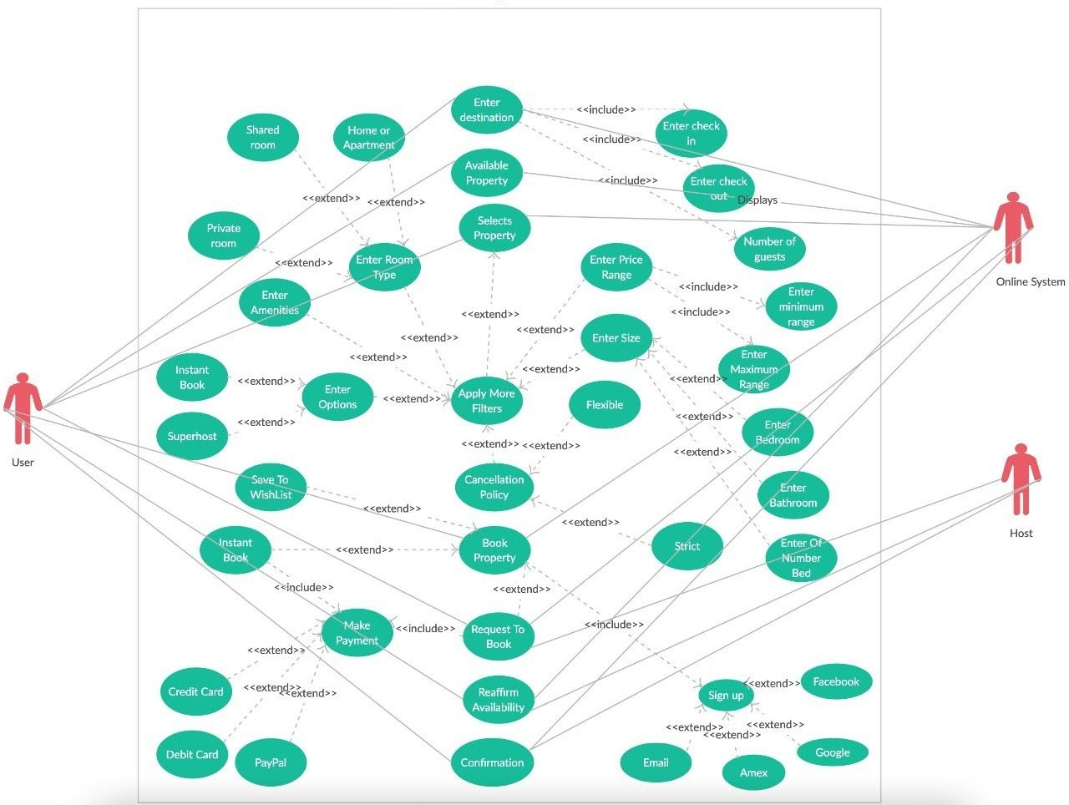
Use Case Diagram

Slide 7
Functional Requirements
For each of the functionalities/use cases defined in the user interactions section, we will specify the exact verbose details in this section for better explainability, and to get rid of any possible ambiguities.
Requirement 1 (R1) | Sign up / Login facility
User | Guest/Host
Input | Email ID, Passwords, Third party integrations(Apple ID, Google login, Facebook login)
Output | Database Record, Database successfully updated message
Processing | Validate the given details and record the information into the encrypted personal information database.
Requirement 2 (R2) | ID Verification system
User | Guest/Host
Input | Electronic copy of Identification documents(Passport, International Driving Licence etc.) with a selfie, Phone number
Output | Database Record, Database successfully updated message
Processing | Validate the given details and record the information into the encrypted personal information database only the first time during sign up.
Requirement 3 (R3) | Allow hosts to easily Add New Listings
User | Host
Input | Location, Size of rooms, Number of rooms, Room type, Property verification video including the host(Length min 1 min)
Output | Database Record, Database successfully updated message
Processing | Validate the given details, record the information into the database and show the listing with location info on the website/app.

Slide 8
Requirement 4 (R4) | Guests enter Primary Guest Input (destination) into the system
User | Guest
Input | Destination location
Output | Database Record, Database successfully updated message
Processing | Validate the given details, and query the database to show the listings available in the destination location.
Requirement 5 (R5) | Guests enter Secondary Guest Inputs for fine-tuning their choices
User | Guest
Input | Number of guests, Price range, Date range, Presence or absence of pets, Size of room required, Room type (home, private room, apartment, shared room), Basic amenities available (cooking utensils, washing machines, etc.), Number of beds required, Number of bathrooms required, Desired, Cancellation policy (strict, flexible), Minimum desired rating of host
Output | Display a message with available room/house details
Processing | Validate the given details, and query the database to check for the available rooms/houses in a given time period satisfying user inputs and return it’s availability.
Requirement 6 (R6) | Guests create a wishlist (shortlist of their choices)
User | Guest
Input | Choices made by the user from the available properties
Output | Database Record, Database successfully updated message
Processing | Validate the given details, record the information into the database.

Slide 9
Requirement 7 (R7) | Guests Finalize Bookings
User | Guest
Input | Choice made by the user from the available properties by searching or from his created wishlist
Output | Database Record, Database successfully updated message
Processing | Validate the given details, record the information into the database, display the Cancellation Policies for the property
Requirement 8 (R8) | A Messaging System between hosts and guests
User | Guest/Host
Input | Sender ID, Receiver ID, strings of messages
Output | Database Record, Database successfully updated message
Processing | Validate the given details, record the information into the database, create real-time connection between two parties and take messages from the sender and display it to the receiver.
Requirement 9 (R9) | Multiple payment methods
User | Guest
Input | Total Pay time, Credit/Debit card details, Third party integrations(Net banking, PayPal etc)
Output | Database Record, Database successfully updated message
Processing | Validate the given details and record the information into the database.

Slide 10
Requirement 10 (R10) | Issue Receipts to the guests on booking confirmation
User | Host
Input | Billing no, Quantity, Price, Taxes, Date, Services, Unit
Output | Database Record, Database successfully updated message
Processing | Validate the given details and query the database to calculate total cost according to the services gained by the guest. Generate an electronic version of the receipt (automatically by the system) and mail a copy to the guest.
Requirement 11 (R11) | Check-in / Check-out facility
User | Guest
Input | Check-in, Check-out, Number of days
Output | Database Record, Database successfully updated message
Processing | Validate the given details and record the information into the database and make the property unavailable for further booking from check-in date to check-out date midnight.
Requirement 12 (R12) | A Rating system for both guests and hosts
User | Guest/Host
Input | Rating between 1 to 5 range
Output | Database Record, Database successfully updated message
Processing | Validate the given details and record the information into the database.

Slide 11
Requirement 13 (R13) | Guests can share their public profiles to different social media
User | Guest
Input | Third Party Integrations (Google, Facebook, Twitter etc.)
Output | Message with link to a person’s public profile on the website
Processing | Validate the given details and share the generated link to users preferred social media.
Requirement 14 (R14) | Guests can plan their itinerary within the application
User | Guest
Input | Activity, Date, Third Party Integrations (Google Calendar, Apple Calendar etc.)
Output | Database Record, Database successfully updated message
Processing | Validate the given details and record the information into the database and create a reminder on calendar for the particular activity and date combo, also show a notification on the app.
Non Functional Requirements
Internal Components of Application
Verification System :
This system will have 2 major components.
User Verification
Needs to implement facial recognition to match photos from official documents like passports, driving license, etc., with a real-time selfie. Can impose some basic restrictions on the selfie, for lighting conditions and pose, to ensure higher authenticity rates of profiles.
Listing Verification
Needs to implement object recognition to match scenes from a video of the room tour uploaded by the host with the photographs of the property uploaded by the host for the listing. High authenticity needs to be ensured to guarantee safety of guests and avoid potential legal consequences.

Slide 12
Both, users and listings, need to be verified before being allowed to use the platform for ensuring maximum security.
Encrypted Personal Information Database :
All the information provided by users during signup will be stored in this database. Queries will be made during every login attempt and also when the public profile of a user is being viewed. The rules regarding the visibility of the user’s profile have already been defined previously. One additional rule is that, even when a user shares their public profile, they may choose to hide particular portions of the profile, for example, phone number or email address. Encryption of this database is necessary to prevent accidental leaks and protect against cyber-attacks to the system. User ratings will also be stored in this database. Higher rated hosts will have their listings shown at the top of the results page of any user query. Similarly, if multiple guests are trying to book the same listing, they will be ordered in decreasing order of their ratings in the host interface.
The system will need to be initially implemented to handle at least 100,000 queries per day, with scope to scale it easily later on when the user base grows. This would need efficient caching algorithms to be implemented internal to both the database and the application.
Operating Environment of Application
➔ Hardware requirements
All versions of Windows, Linux and MacOS less than 10 years old are supported.
The application is also supported on mobile devices for both Android and iOS.
The minimum requirement is to either have at least an i5 processor based system for desktop or a mobile phone with a touch screen to access the
application.
A printer will be needed to print receipts.
➔ Software requirements
The latest version of any web browser is needed to access the platform from desktop or mobile, if not using the app from the app store.
If the user is using the app, automatic updates will be pushed from time to time to improve user experience based on feedback.
On the user side, there is no need for any additional SQL software to be installed,
because the data from the application is transmitted securely to the system’s SQL servers in the cloud.

Slide 13
➔ Communications Interfaces
When a booking is confirmed, an email receipt will be sent to both host and guest for that transaction immediately. To achieve that functionality, it requires having a stable internet connection. Mostly a broadband connection should work fine.
➔ Performance Requirements
Performance requirements define acceptable response times for system functionality.
Although the application is developed to work even with minimal system
performance, the performance of the application will highly depend on the performance of the hardware and software components of the system where it is being accessed from.
When considering the timing relationships of the system,
The load time for user interface screens shall take no longer than two seconds.
The log in information shall be verified within five seconds.
➔ Safety Requirements
There are 2 types of users possible for the system. Hence, there will be 2 different views and functions. Access to the various subsystems will be protected by a user login screen that requires a username and password to accommodate both the views of the users.
Maintaining regular backups will ensure the system database integrity. System can be restored in any case of emergency.
➔ Security Requirements
The application developers can login to the system at any time and access the database without gaining access to the private information of any particular user. This can be implemented very easily using differential privacy mechanisms.

Slide 14
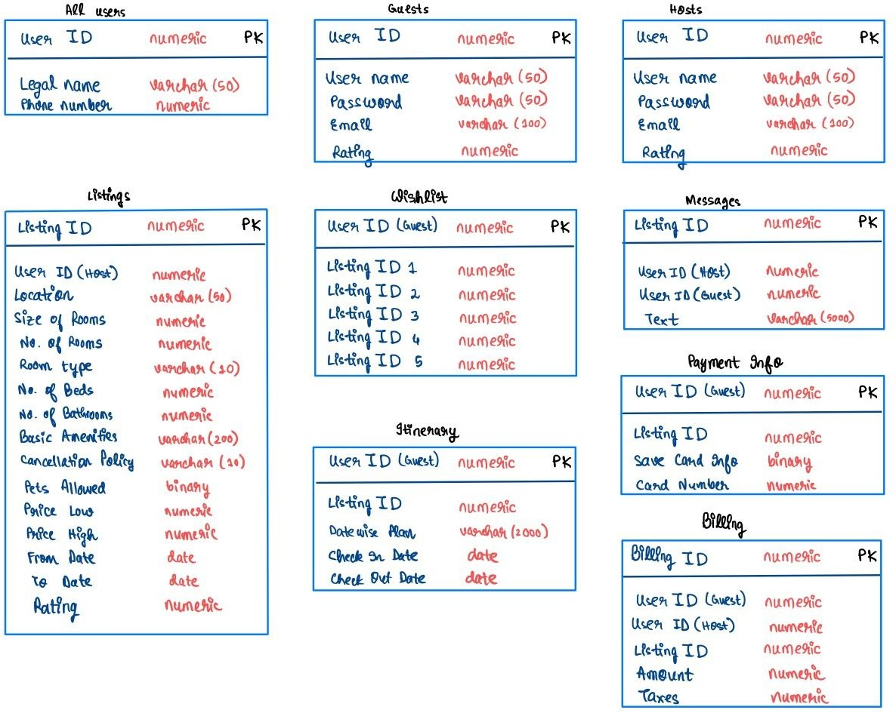
Data Modelling
For the purpose of this document, we will focus only on the database schema for our use case. Our database will have 9 tables to store all the information about users and their interactions with the system and with each other as can be seen in the schema diagram below.
For this diagram, we have included for each table, the expected data type as well. There is clearly some redundancy in the primary design of this table. Some of it is intentional, to improve its robustness. The unnecessary redundancies can be removed during the design phase.

